Slide 1

Hand Gesture Controlled PowerPoint System
By -
21071A7259 – Anihant.G
21071A7259- Navyasree.R
21071A7261 - Saatwik.A

Slide 2
Introduction
Presentations, being a cornerstone of communication in various professional, academic, and public settings, demand innovative solutions for seamless control and engagement. Traditional input devices often fall short in meeting the dynamic needs of presenters, prompting the exploration of novel methods. The proposed hand gesture-controlled PowerPoint system emerges from this necessity, aiming to redefine the presenter's experience by introducing an interactive and intuitive control mechanism.

Slide 3
OBJECTIVE
The core objectives of the system encompass not only enhancing the presenter's control over their slides but also fostering a more inclusive and accessible presentation environment. By removing the reliance on physical input devices, the system empowers presenters to deliver their content more freely. Additionally, the focus on personalization and accessibility ensures that individuals with mobility impairments can participate in the presentation process with greater ease and independence.
The hand gesture-controlled PowerPoint system employs a multifaceted approach, integrating advancements in gesture-based human-computer interaction. At its core, the system utilizes machine learning algorithms to decipher and map hand movements accurately. This not only facilitates smoother slide control but also opens avenues for innovative gestures, enhancing the overall presentation experience
.

Slide 4
PROPOSED SYSTEM
1.Enhanced Gesture Recognition :
The proposed system introduces advancements in gesture recognition through the application of advanced computer vision techniques and machine learning algorithms. By leveraging deep learning models, the system endeavors to accurately recognize a diverse range of hand gestures, allowing presenters to express their intentions with precision.
2.Improved Accuracy and Responsiveness :
Recognizing the critical importance of real-time responsiveness, the proposed system places a strong emphasis on refining accuracy. By mitigating false positives and negatives, the system aims to create a responsive and reliable interaction platform for presenters.
.

Slide 5
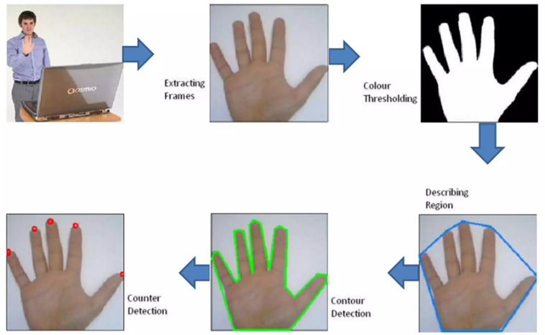
PROPOSED SYSTEM
.

Slide 6
PROPOSED SYSTEM
3.Integration with Multiple Platforms :
Recognizing the diversity of presentation software, the proposed system is designed to be platform-
agnostic. It seeks to integrate seamlessly not only with Microsoft PowerPoint but also with other popular
platforms such as Google Slides and Apple Keynote, ensuring widespread applicability.
4.Additional Functionalities :
Moving beyond basic slide navigation, the proposed system introduces a spectrum of additional
functionalities. From dynamic zooming to real-time content highlighting, the system expands the
presenter's toolkit, enabling a more engaging and interactive presentation experience.
.

Slide 7
IMPLEMENTATION DETAILS
1.Technology Stack :
The technology stack comprises a sophisticated amalgamation of machine learning frameworks
(TensorFlow, PyTorch), computer vision libraries (OpenCV, MediaPipe), and presentation software APIs.
This comprehensive stack forms the backbone for a robust and adaptable system architecture.
2.System Architecture :
The system architecture is intricately designed to accommodate the complexities of gesture recognition
and presentation control. Modules for hand gesture detection, machine learning model interfaces, and
seamless communication with presentation software contribute to a cohesive and scalable architecture.
.

Slide 8
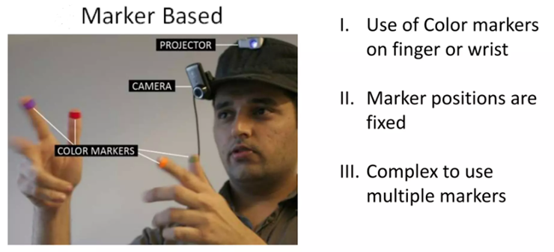
IMPLEMENTATION DETAILS
3.User Interface Design :
User interface design is a pivotal aspect of the system's usability. The interfaces are crafted with a focus
on user-friendliness, providing presenters with intuitive controls for customizing gestures, viewing real-
time feedback on recognition, and effortlessly navigating through their presentations.
.

Slide 9
RESULTS and EVALUATION
1.Performance Metrics :
The evaluation of the system's performance involves a meticulous examination of various key metrics to ensure its effectiveness and reliability.
a)Gesture Recognition Accuracy :
A fundamental aspect of the system's success lies in its ability to accurately recognize and interpret hand gestures. To measure accuracy, a comprehensive dataset comprising a diverse range of gestures is utilized. The system is evaluated based on its ability to correctly identify and respond to predefined gestures, ensuring a high level of precision in slide control and additional functionalities.
.

Slide 10
RESULTS and EVALUATION
b)Responsiveness :
The responsiveness of the system is a critical factor in creating a seamless and natural interaction experience. Metrics for responsiveness include the time taken between a recognized gesture and the corresponding system action. A low-latency response is crucial for maintaining the presenter's flow and engagement with the audience.
.

Slide 11
CONCLUSION
The hand gesture-controlled PowerPoint system represents a groundbreaking innovation in the realm of presentations, successfully addressing the limitations of traditional control methods. By leveraging advanced technologies such as machine learning, deep learning, and computer vision, the system offers presenters an intuitive and dynamic means of interacting with their content. The focus on inclusivity and accessibility ensures that individuals with mobility impairments can participate more actively in the presentation process, fostering a more equitable environment. The proposed system's versatility is underscored by its platform-agnostic design, seamlessly integrating with various presentation software beyond Microsoft PowerPoint. The inclusion of advanced functionalities, such as customizable gestures and real-time content highlighting, enriches the presenter's toolkit, contributing to a more engaging and interactive presentation experience. Rigorous testing, both quantitatively and qualitatively, validates the system's performance and user-friendliness. While overcoming challenges encountered during development, the system paves the way for future enhancements, emphasizing continuous innovation. In achieving its objectives, the hand gesture-controlled PowerPoint system emerges not only as a transformative tool for presenters but also as a catalyst for shaping the future landscape of human-computer interaction and interactive communication.
.

Slide 12
THANK YOU
.

